Slide 1
Russell Bayou Lift Station Property Needs
November 15, 2018 5:30p
Perdido Bay United Methodist Church / Community Center

Slide 2
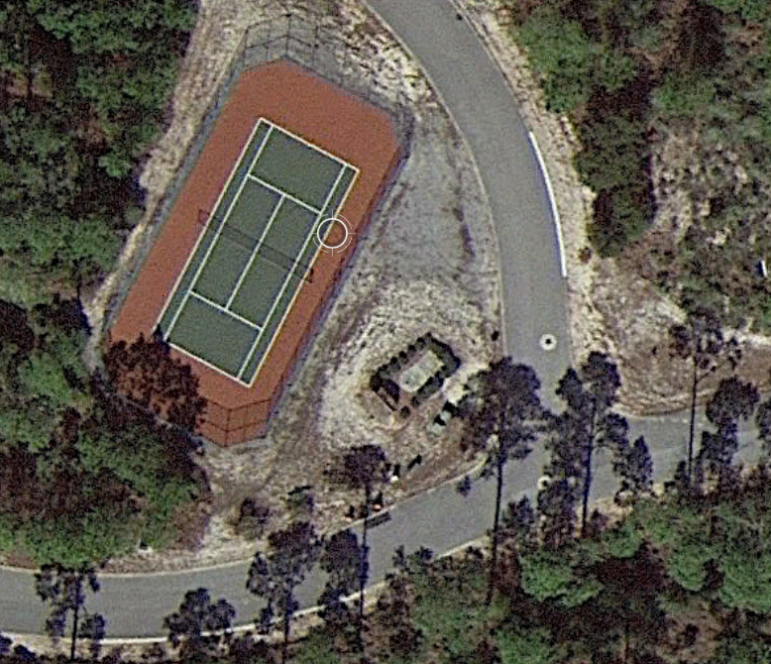
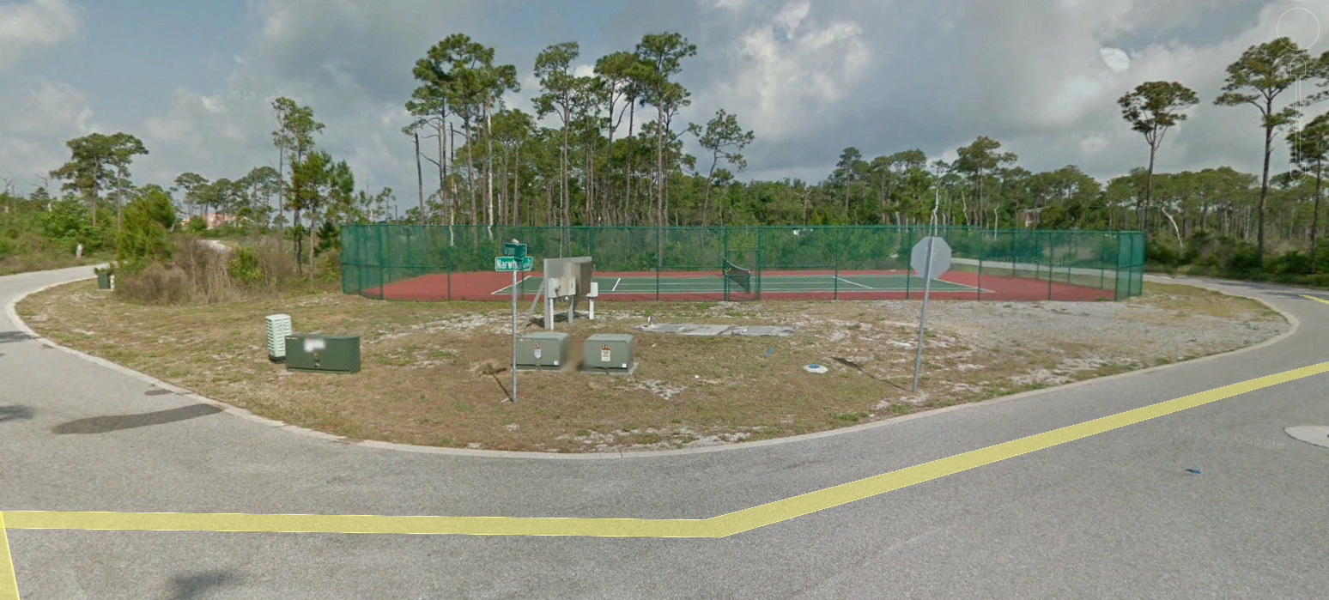
Aerial / Street View (Google Earth)

Slide 3
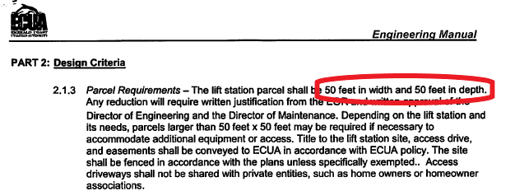
ECUA Requirements

Slide 4
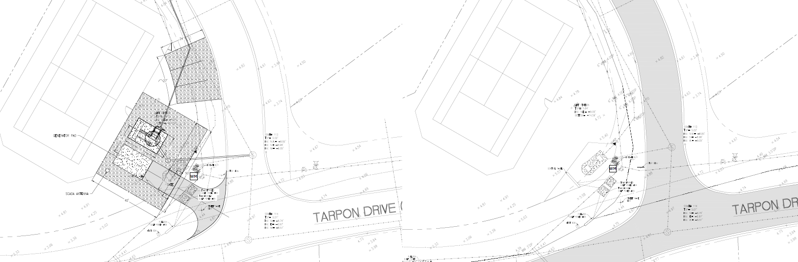
Drawings
Proposed Existing

Slide 5
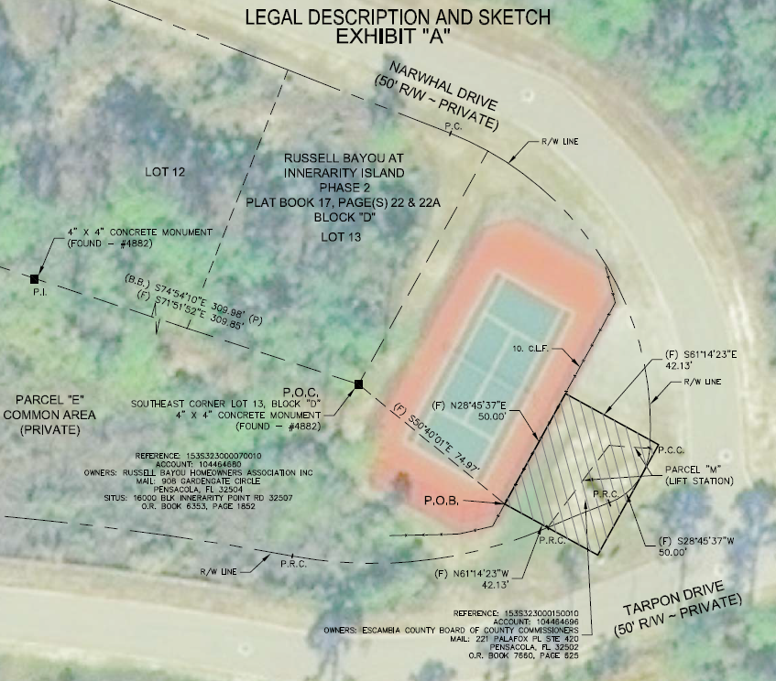
Parcel Location

Slide 6
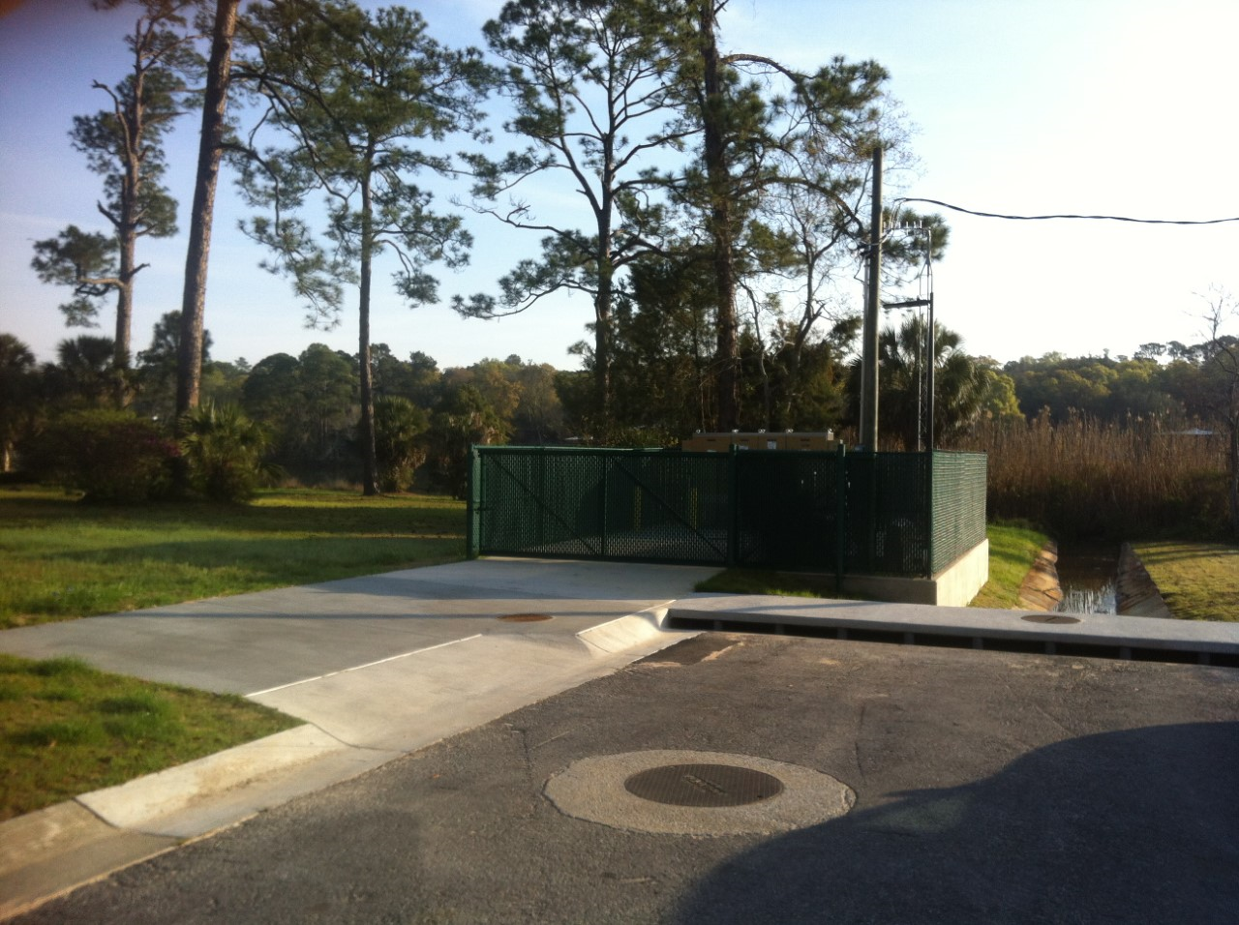
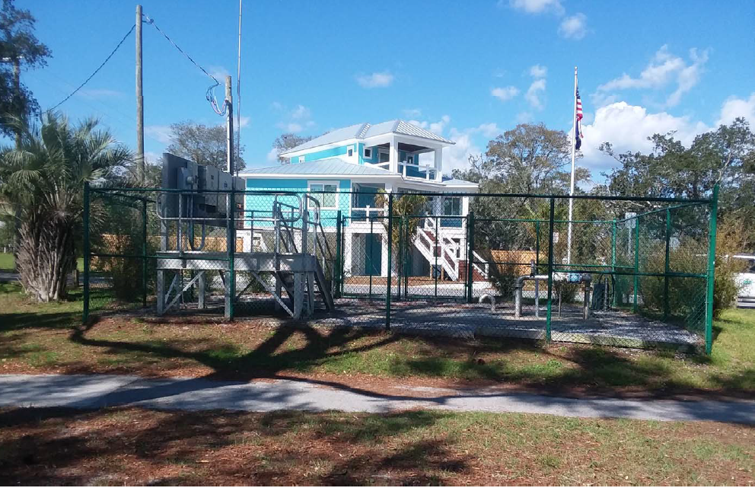
Landscaping / Fencing Examples

Slide 7
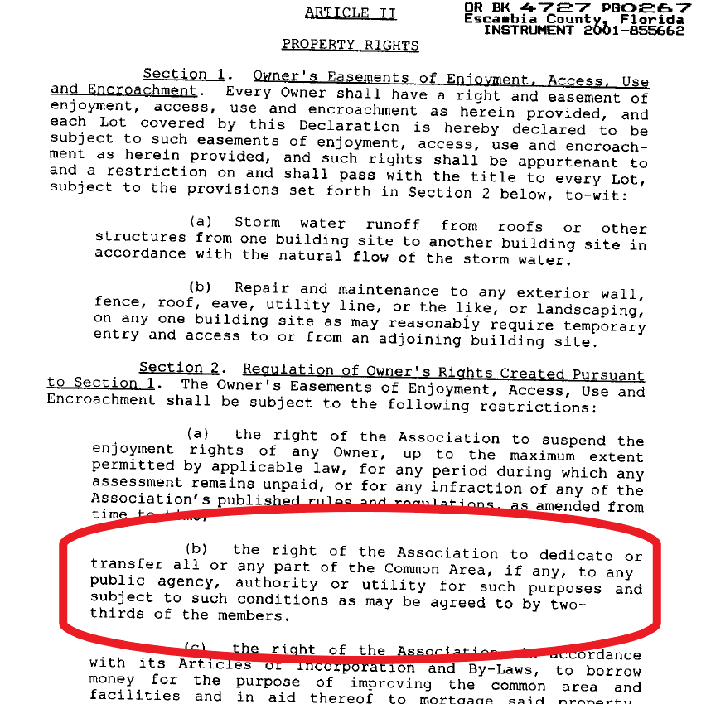
Russell Bayou Covenants and Restrictions

