Slide 2
Table of Contents
Home Owner Association Members
Reporting Issues or Violations
Home Owner Association Dues
Architectural Review Committee (ARC) Requests
Covenants, Conditions, & Restrictions (CCRs)
By-Laws
Plat Map
Announcements
Suggestions or Recommendations

Slide 3
Home Owner Association Members
Dean Dukes (President)
Contact Information: (352) 229-3221 or Magnolia.Glen.HOA.Milton@gmail.com
Luis Marty (Vice-President)
Chauncy Hamilton (ARC Lead)

Slide 4
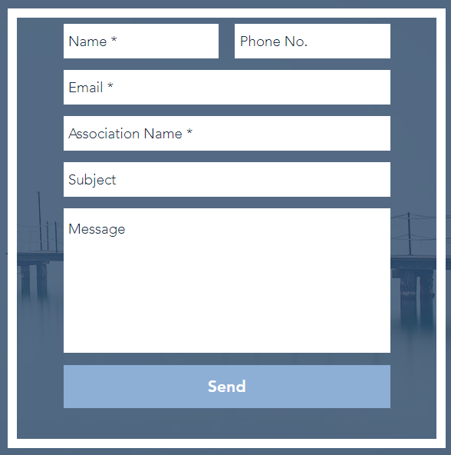
Reporting Issues or Violations
Please report all issues and violations via one of the following methods:
Email: Magnolia.Glen.HOA.Milton@gmail.com
Navigate to: Https://www.epmfl.net
Scroll to the bottom of the page
Enter your information:
For Gate Issues please email: Magnolia.Glen.HOA.Gate@gmail.com

Slide 5
Home Owner Association Dues
Please navigate to: Https://www.epmfl.net
At the top of the page, select the “Pay Dues” link
Dues are $350.00 per year (equates to $29.17 per month)

Slide 6
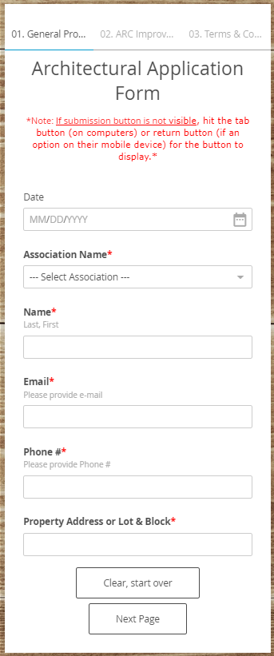
Architectural Review Committee (ARC) Requests
Please navigate to: Https://www.epmfl.net
Hover over “Associations” and Select “Architectural Request
Read the page in its entirety
Fill out the form on the bottom right of the page
***If there is any question on what requires an ARC Request, please feel free to email Magnolia.Glen.HOA.ARC@gmail.com ***

Slide 7
Covenants, Conditions, & Restrictions (CCRs)
Please navigate to: Https://www.epmfl.net/associations
Scroll past “Our Associations” and locate Magnolia Gen
Select “Magnolia Glen”
Select “Covenants, Conditions, & Restrictions” or “1st Amendment to CCR’s”

Slide 8
By-Laws
Please navigate to: Https://www.epmfl.net/associations
Scroll past “Our Associations” and locate Magnolia Gen
Select “Magnolia Glen”
Select “By-Laws”

Slide 9
Plat Map
Please navigate to: Https://www.epmfl.net/associations
Scroll past “Our Associations” and locate Magnolia Gen
Select “Magnolia Glen”
Select “Plat Map”

Slide 10
Announcements
Please navigate to: Https://www.epmfl.net/associations
Scroll past “Our Associations” and locate Magnolia Gen
Select “Magnolia Glen”
Select link to applicable announcement (additional link will be added for common requested items (i.e… Meeting Minutes, Community Events, etc…)

Slide 11
Suggestions or Recommendations
Please send all suggestions to:
Magnolia.Glen.HOA.Milton@gmail.com

